Slide 1


UMKC-Game ON
Team Members (Project Group-16):
Golla Ranga Kousik - 16322459
Nagula Ajay Kumar - 16327661
Mamjala Manisha - 16307984
Chenna Srinivas - 16307995

Slide 2
Game ON is a holistic Sports Application which helps to bring back Play in everyone’s lifestyle.
Goals and Objectives:
Our primary goal is to establish connections by making new playpals, organizing playgroups, sharing the information or the experiences, discovering the sporting venues activities and lending sport items.
Key Features:
Book a Sports Venue
Create an activity
Blog (Articles)
Lending sport equipment

Slide 3

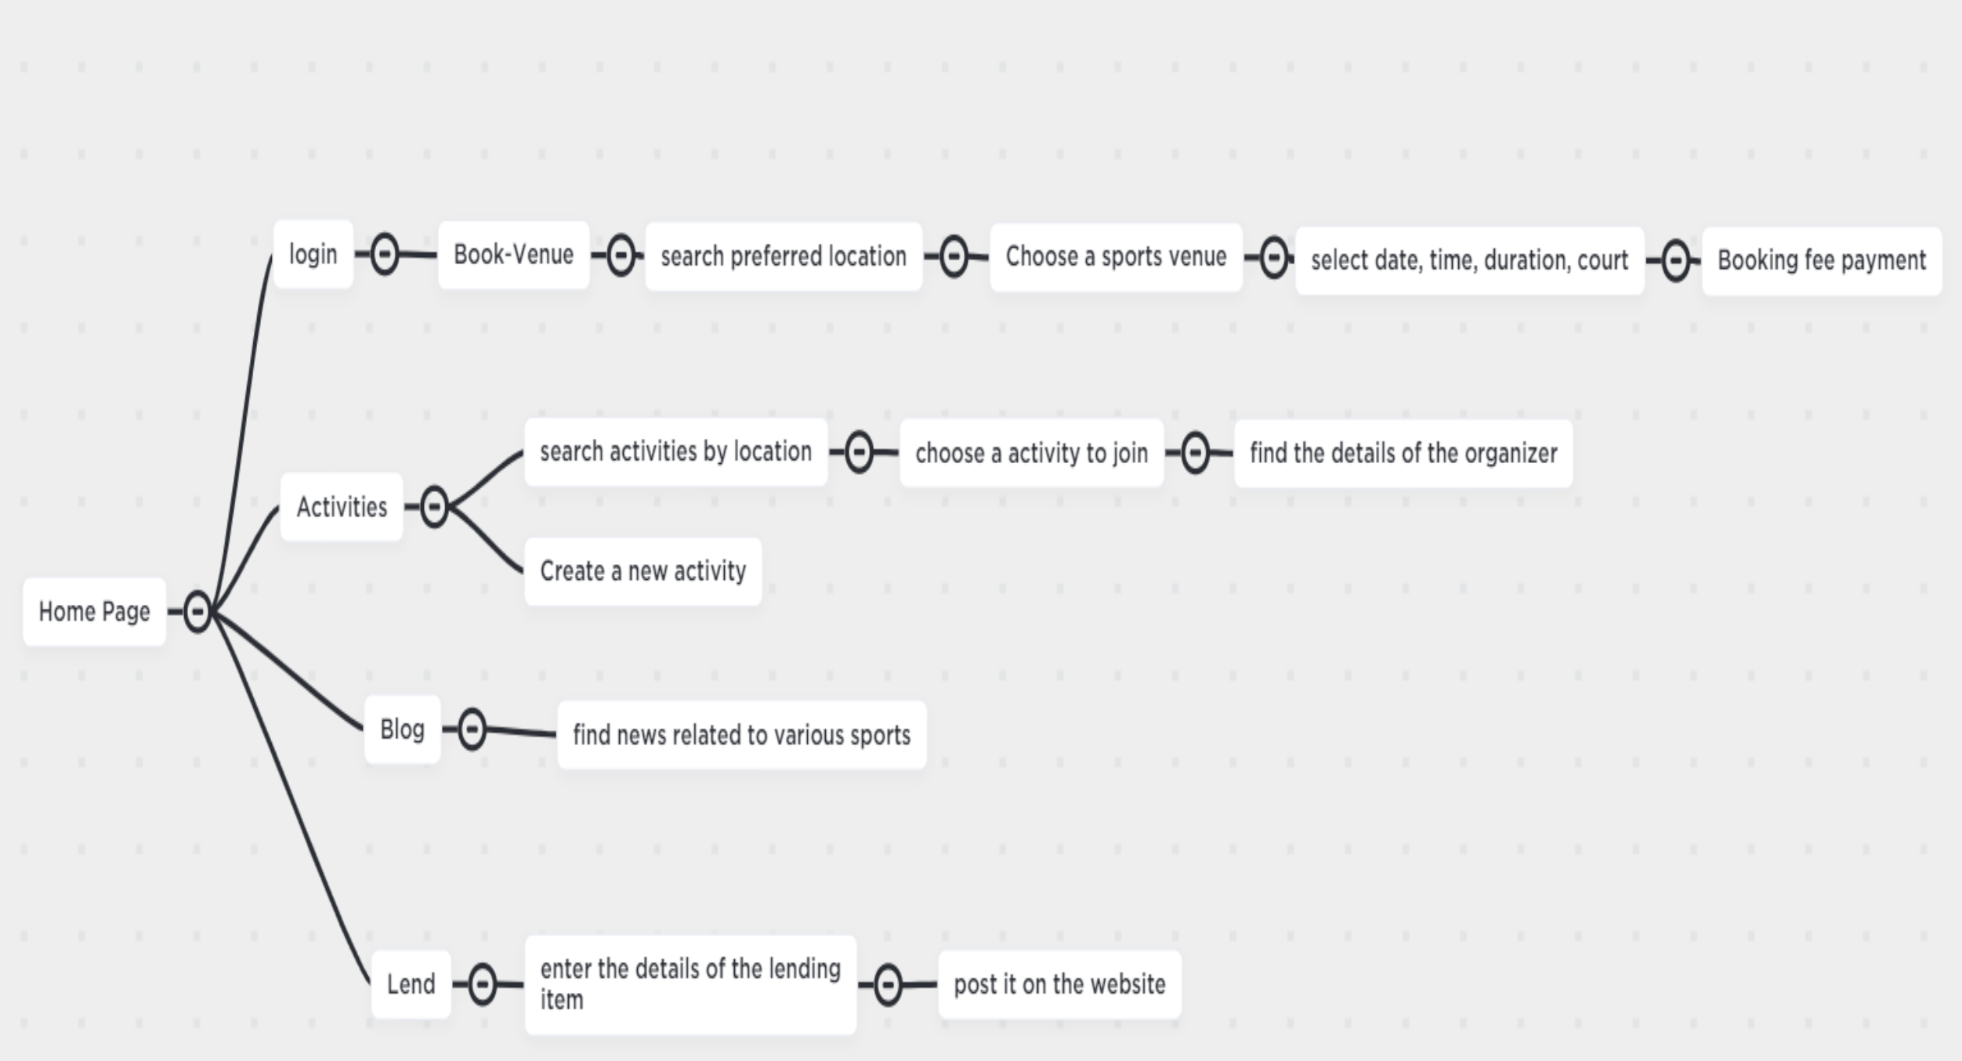
Website Flow:

Slide 4

Home Page

Slide 5
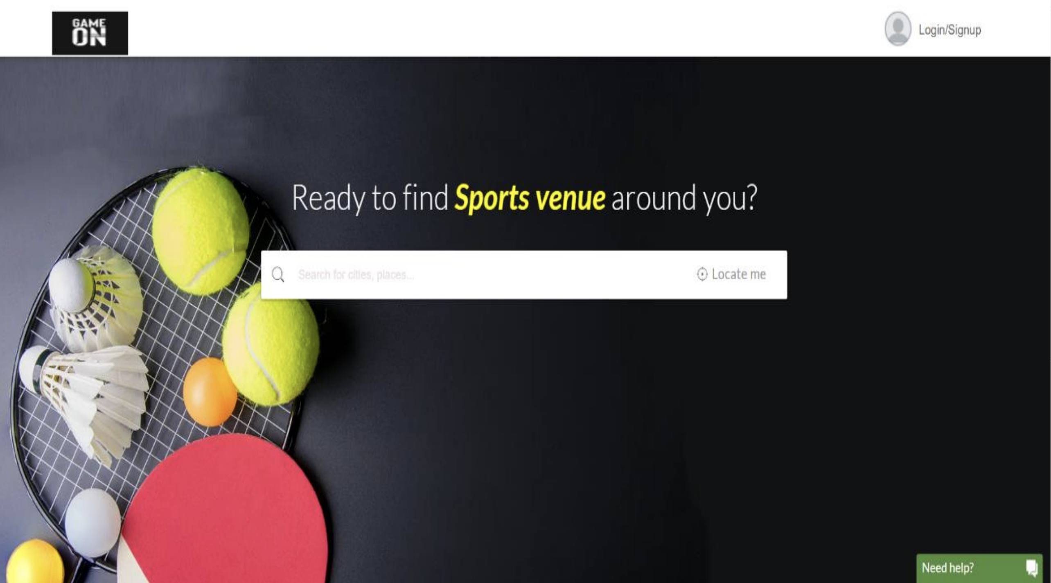
Book Venues
User can find the nearby venues by passing the location information

Slide 6
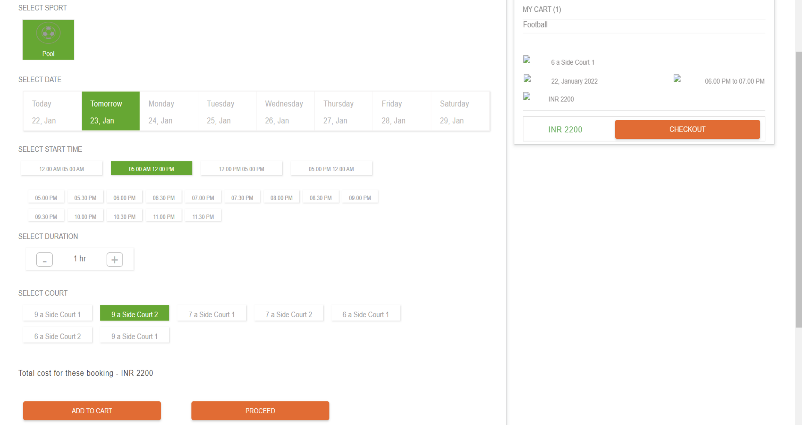
Booking Venue

Slide 7
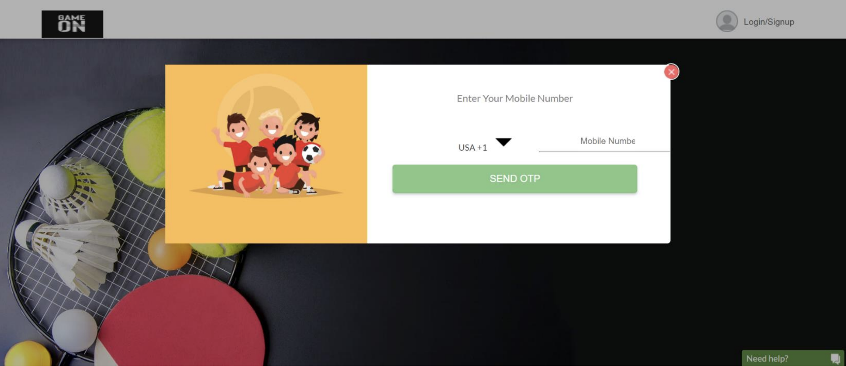
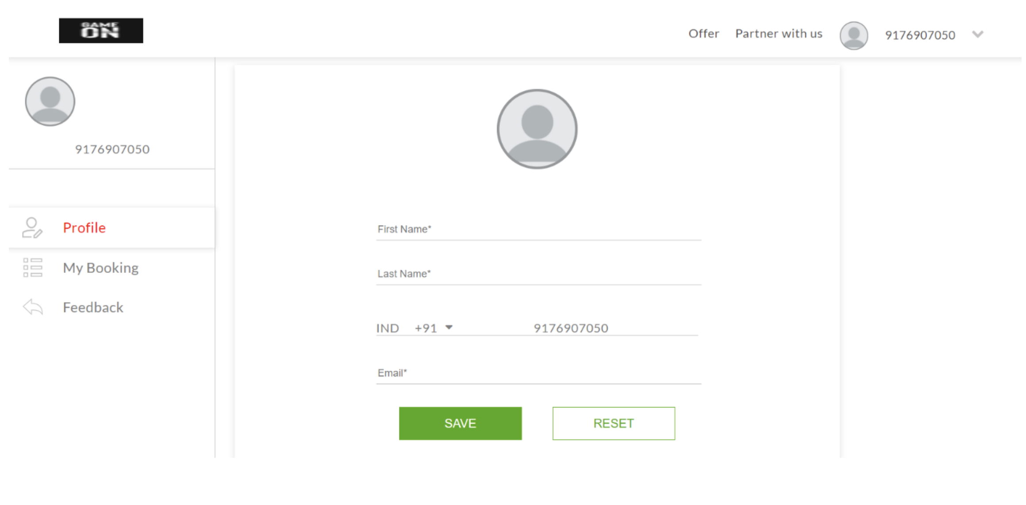
Login/SignUp
Profile Information

Slide 8
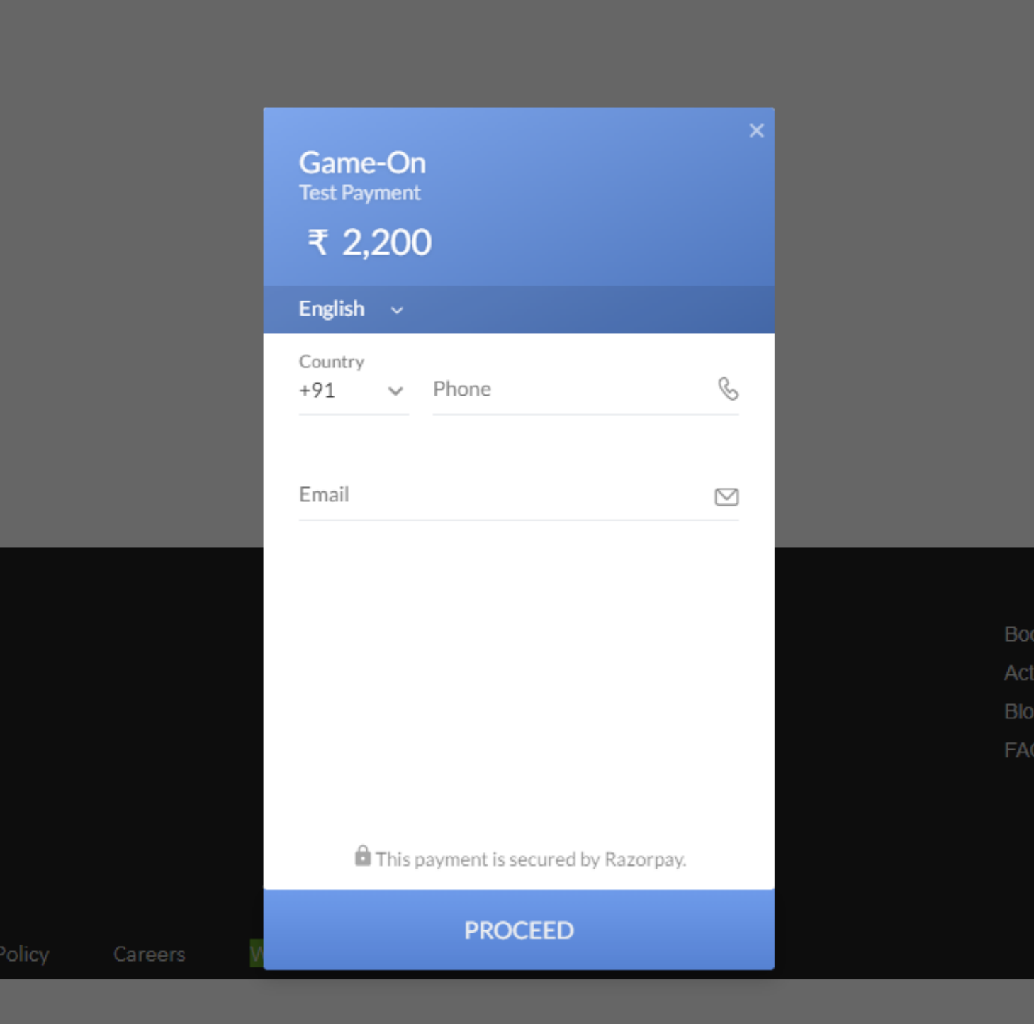
Payment

Slide 9
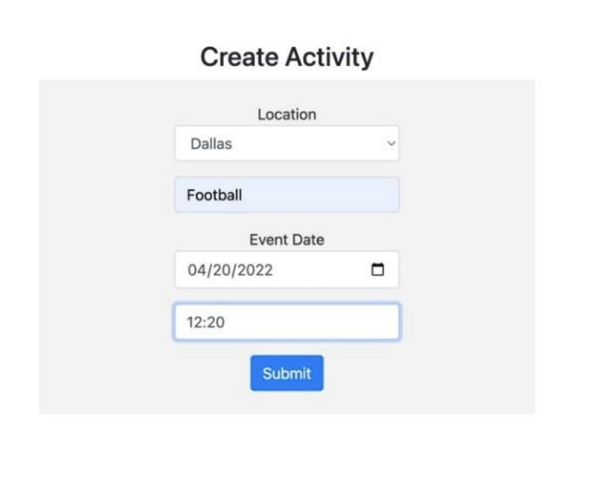
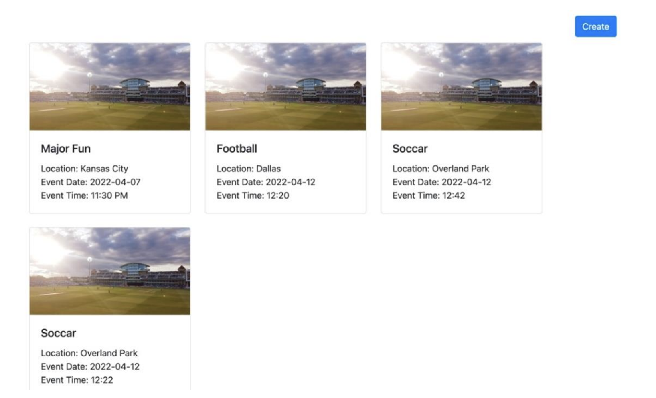
Creating an Activity

Slide 10
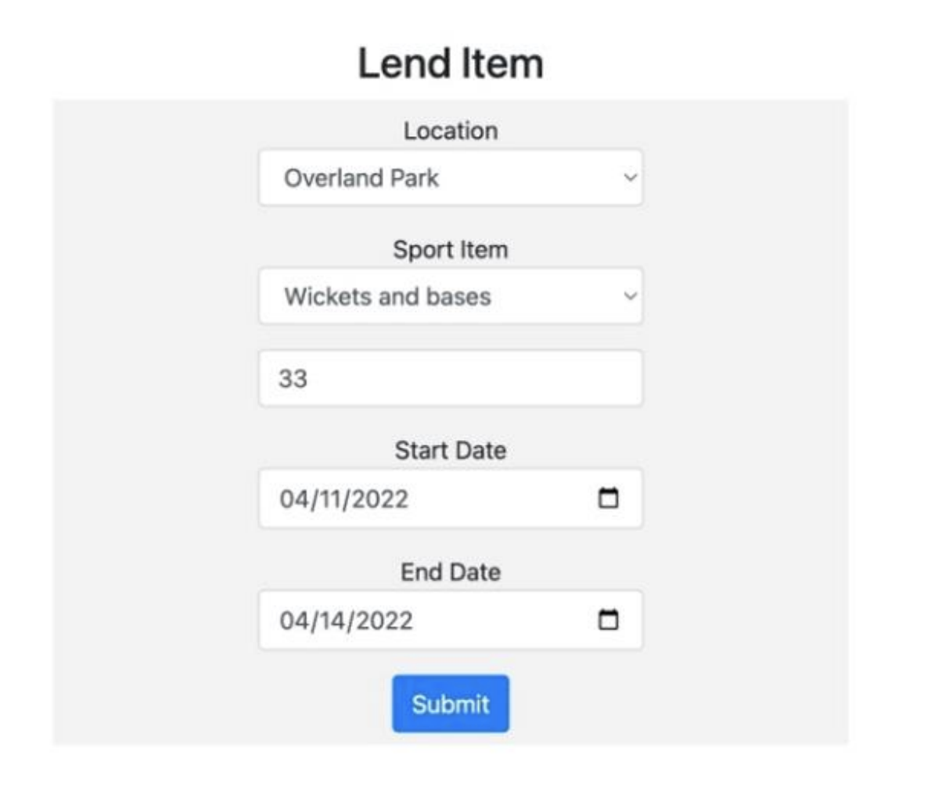
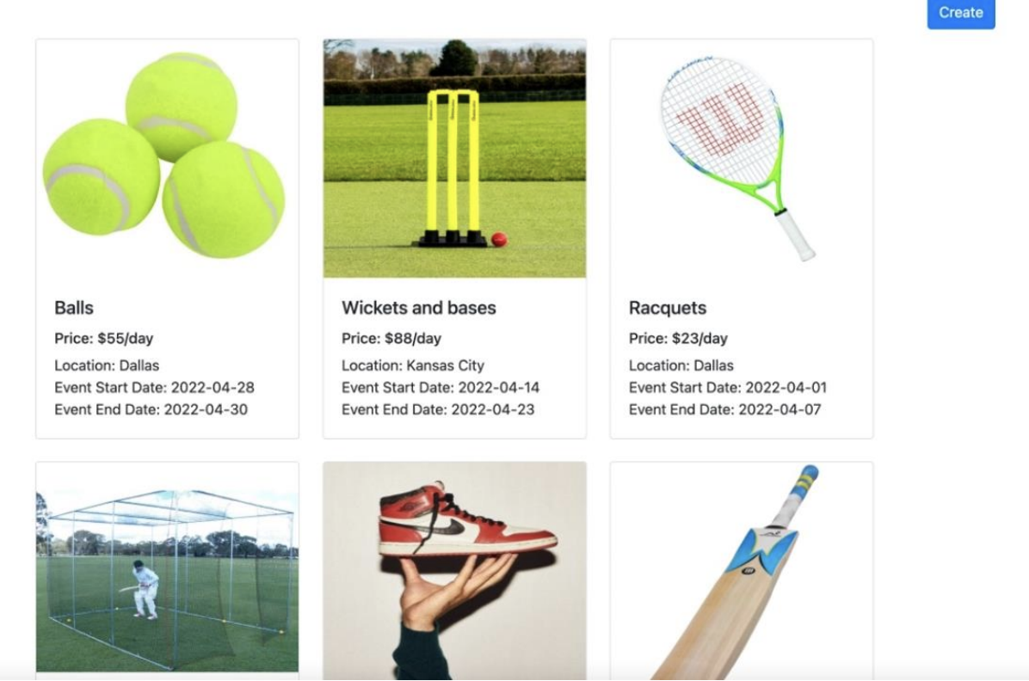
Lending a sport equipment

Slide 11
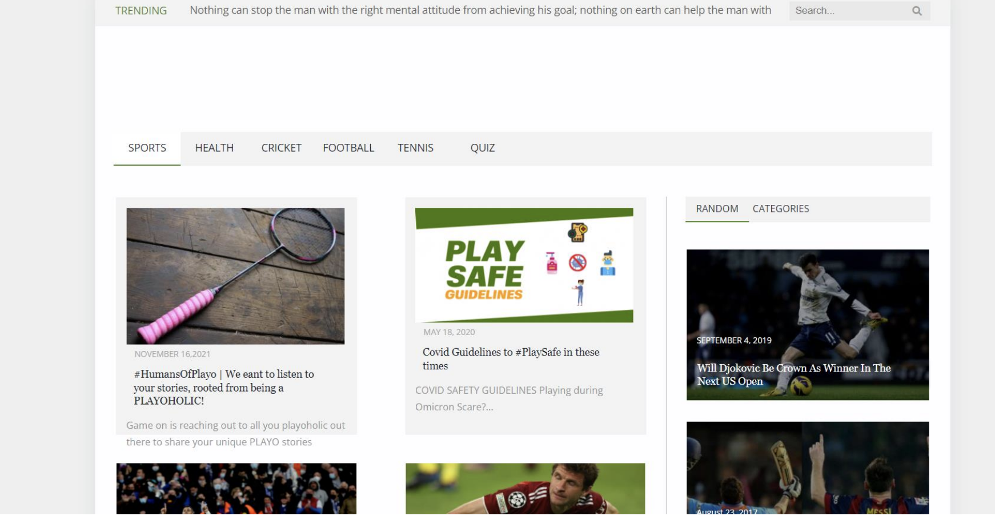
Blog Page with Search Feature

Slide 12

Thank You

